Slide 1
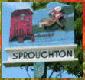
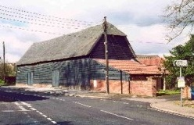
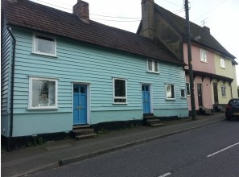
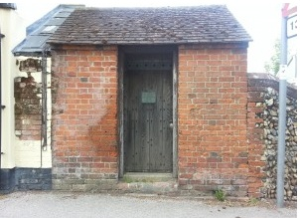
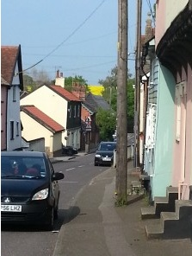
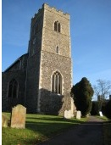

Sproughton Parish Council
Annual Parish Meeting (Year End 31Mar21)
Tue 4th May 2021

Slide 2
Sproughton Parish Council
Our Councillors
  Helen Davies (Chair), Peter Powell (Vice Chair), Simon Curl, Jennifer King, Sharon Maxwell, Zac Norman & Iain Selby.
Our Clerk
  Kirsty Webber has been in post for just over a year joining at a very challenging time due to the pandemic
  Kirsty can be contacted at SproughtonPC@gmail.com, 07538 311567, @SproughtonPC
  We have a new address due to the installation of a post & parcel box in the courtyard of the Tithe Barn

Slide 3
Our Committees
Planning Committee
Neighbourhood Plan Committee
Sproughton PC
Finance Committee
Burial Committee
HR Committee
Beer Festival Committee

Slide 4
The Past Year – Committees
Sproughton Parish Council Committee
  Met every month including the normal holiday month of August due to the volume of work
Planning Committee
  Met fortnightly, each month to consider 65 planning applications. There were many additional meetings (inc meetings with developers & Babergh) to consider the Pigeon, Hopkins Homes & Taylor Wimpey sites.
Finance Committee
  Met four times to consider financial matters such as budgets, precept & annual audit.
HR Committee
  Met several times to consider employment issues
Burial Committee
  Newly re-instated. Has met once to consider burial matters
Neighbourhood Planning Committee
  Formed early 2020. Has met monthly to work on the Neighbourhood Plan. There have been a large number of ancillary meetings to discuss specific issues
Beer Festival Committee
  Has met briefly to discuss holding the Beer Festival in 2021. Unfortunately the answer was ‘no’ ☹

Slide 5
Allotments
The Parish Council leases the allotments from the Felix Thornley Cobbold Trust and manages these on a day to day basis.
FTCT annual rent = £445.00
Rental income from plot holders = £886.53
All plots are rented out
Allotments should be expanded as part of the Pigeon Land Management/FTCT development

Slide 6
Burial Ground
Sproughton PC authorises burials and the erection of memorials.
SPC is responsible for the management of the burial ground in Church Lane
Regular maintenance takes place e.g. grass & hedges cut, paths cleared & swept and cleared.
Restrictions have been in place this year due to the pandemic restricting numbers who can attend burials and internments.
Signs displayed to ensure it was COVID safe
Six burials within the last year.
Two internments outstanding
Sproughton PC has begun to consider expansion of the burial ground

Slide 7
Tithe Barn
Sproughton PC manages the use, maintenance & improvement of this important village resource
Our Tithe Barn warden is David Barnes who manages day to day use of the barn, assists with hiring arrangements, ‘meets and greet’ hirers and overseas any functions.
Sproughton PC is the ‘Designated Premises Supervisor’ administering the requirements of the Premises Licence (change to previous arrangements).
Due to the pandemic the Barn has sat empty for the last year resulting in a significant loss in income. SPC approved the payment of a retainer to the Barn Warden for the duration of the pandemic
However now restrictions are lifting enquiries are increasing.

Slide 8
Sproughton PC – Planning Work
Pigeon Land Management/FTCT (105 homes)
  SPC & the Sproughton Working Group had several meetings with Pigeon & Babergh to discuss the application aiming to mitigate the impact and improve the application
  A large campaign was mounted in conjunction with the SWG to encourage comment – over 350 objections were made
  Sadly the application was approved by Babergh with a vote of 6-5
Hopkins Homes
  This application was for 79 homes originally but later reduced to 49
  This was another big campaign, again SPC working with the SWG.
  This application was heard & refused twice by the Babergh Planning Committee
  Hopkins appealed the decision & after a 5day hearing it was dismissed
  A huge amount of resource was expended on this, in councillor & SWG time, all on a voluntary basis

Slide 9
Sproughton PC – Planning cont…
Taylor Wimpey Phase 2
  Expecting the TW P2 application in May’21
  SPC & the NP Committee have met with TW on several occasions to comment on proposals and to communicate the requirements of our new Design Codes
  TW have been more forthcoming on this Phase of the development than P1 for which SPC are grateful
Sproughton Enterprise Park
  Three additional plots have been sold on the old Sugar Beet site so applications should be expected in the future

Slide 10
Sproughton Neighbourhood Plan
This project began in Jan’20
Neighbourhood Plan Committee set-up consisting of members of the Parish Council & Sproughton Working Group, chaired by Rhona Jermyn of the SWG
The plan area was approved in Apr’20
Questionnaire compiled & distributed to the parish Jul’20
A Public exhibition was held in the Tithe Barn in Sep’20
Landscape Assessment & Design Codes approved Mar’21
Second draft of the Plan under review by critical friend prior to submission to Babergh, target May’21
Target completion date Q4’21/Q1’22 (dependent on Babergh & Planning Inspector availability)

Slide 11
Other Initiatives
Quiet Lanes
  We are in the process of getting two lanes designated in the village as quiet lanes.
  A Quiet Lane is a nationally recognised designation of single-track road (i.e. no line markings), typically with less than 1,000 vehicle movements per day.
  Quiet Lanes EXPECT the lane to be used by a variety of people, animals and transport, and to RESPECT each other’s rights to considerate road use!
  Proposed lanes are Church Lane and the Grindle.
Speedwatch
  Spearheaded by a local resident currently on hold due to the pandemic
Speed Limit within the Village
  Attempting to get a 20mph limit outside the primary school
  Considering if a 20mph limit could be extended throughout the village
Children’s Playground
  Working with the primary school to establish what kind of playground the children would like
  Obtaining quotes to establish ballpark numbers for playground replacement
  Considering funding sources
  Keeping the PFMC updated who manage the Playing Fields
Future Initiatives
  Tree & hedgerow planting in the parish
  Others tbd, some will arise as a result of the Neighbourhood Plan

Slide 12
Finances
FINANCE REPORT
Budget | £67,175.00 | Precept | £54,236.00
Reserves | £394,331.00 | Current Account | £81,402.31
Expenditure
Burial Ground | £ 101.41 | VAT | £ 6,586.83
Allotments | £ 521.53 | Tithe Barn | £ 10,360.38
Grants & Other Activities | £ 1,000.00 | Administration | £ 11,539.18
Street Lighting | £ 3,361.54 | Neighbourh’d Plan | £ 15,629.23
Play Area/Public spaces | £ 5,142.30 | Staff Expenditure | £ 17,033.40
 |  | Total Spend | £71,275.80

Slide 13
Finances cont…..

Slide 14
Thank-You’s go to
All the parish councillors who volunteer their time
Sproughton Working Group who have helped enormously with the campaigns against planning applications in the village
The Neighbourhood Plan Committee who have put in significant hours to get us to this point
Our Tithe Barn Warden
Our village caretakers Mike Herbert Ltd
And all the organisations in the village who put so much time and effort in to benefit the community:-
  Primary School, All Saints Church, The Community Shop, The Millenium Green, The PFMC, The Reading Room, Brownies, Bumble Bees charity, Fireworks Team, Sproughton Covid Volunteers (apologies if I have missed anyone off the list)

Slide 15
Questions under #6

