Slide 1
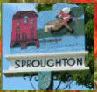
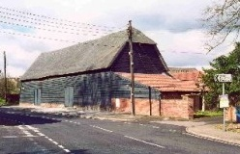
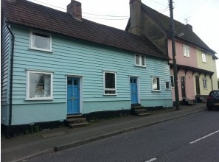
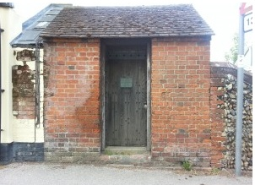
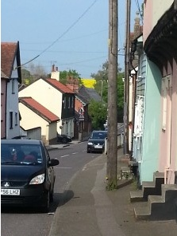
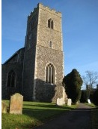

Sproughton Parish Council
Annual Parish Meeting (Year End 31Mar22)
Thursday 5th May 2022

Slide 2
Sproughton Parish Council
Our Councillors
  Helen Davies (Chair), Peter Powell (Vice Chair), Simon Curl, Jennifer King, Sharon Maxwell, Charlie Barber.
Our Clerk
  Kirsty Webber. Kirsty can be contacted at SproughtonPC@gmail.com,
  07538 311567,
  Tithe Barn, Lower Street, Sproughton IP8 3AA

Slide 3
Our Committees
Planning Committee
Neighbourhood Plan Committee
Sproughton PC
Finance Committee
Burial Committee
HR Committee
Beer Festival Committee

Slide 4
The Past Year – Committees
Sproughton Parish Council Committee: Met every month including the normal holiday month of August due to the volume of work
Planning Committee: Met fortnightly, each month to consider 64 planning applications. There were many additional meetings (inc meetings with developers & Babergh) to consider the Pigeon, Hopkins Homes, Sugar Beet site & Taylor Wimpey sites.
Finance Committee: Met twice to consider financial matters such as budgets, precept & annual audit.
Neighbourhood Planning Committee: Formed Jan 2020. Has met monthly to work on the Neighbourhood Plan. There have been a large number of ancillary meetings to discuss specific issues – the plan is be updated to reflect parishioner comments
Beer Festival Committee: Has met to organise this years Beer Festival after a 2 year absence.
Travel Committee: We had a Traffic Panel a few years ago but this stopped as members were not available any longer. However due to the problems on the High Street, this is being resurrected.
HR Committee: Has not met this year
Burial Committee: Has not met this year

Slide 5
Allotments
The Parish Council leases the allotments from the Felix Thornley Cobbold Trust and manages these on a day to day basis.
FTCT annual rent = £445.00
Rental income from plot holders = £834.98
There are currently plots available.
Allotments should be expanded as part of the Pigeon Land Management/FTCT development

Slide 6
Burial Ground
Sproughton PC authorises burials and the erection of memorials & benches.
SPC is responsible for the management of the burial ground in Church Lane
Regular maintenance takes place e.g. grass & hedges cut, paths cleared & swept and cleared.
Sproughton PC has begun to consider expansion of the burial ground.

Slide 7
Tithe Barn
Sproughton PC manages the use, maintenance & improvement of this important village resource
We now have two Tithe Barn wardens 1) David Barnes and 2) Sam Pateman-Gee who manage day to day use of the barn, assists with hiring arrangements, ‘meet and greets’ hirers and overseas any functions.
Sproughton PC is the ‘Designated Premises Supervisor’ administering the requirements of the Premises Licence (change to previous arrangements).
Activities in the are barn are various – Weddings, Parties, Wakes, Badminton, Discos, the Beer Festival and last year two new events – Afternoon Tea Party and ‘a Sproughton Christmas’

Slide 8
Sproughton PC – Planning Work
Pigeon Land Management/FTCT (105 homes)
  SPC & the Sproughton Working Group had several meetings with Pigeon & Babergh to discuss the application aiming to mitigate the impact and improve the application
  A large campaign was mounted in conjunction with the SWG to encourage comment – over 350 objections were made
  Sadly the application was approved by Babergh with a vote of 6-5
  Subsequently we spent many hours with Babergh on the S106 agreement in an effort to get additional resources for the community.
Hopkins Homes
  This application was for 79 homes originally but later reduced to 49
  This was another big campaign. Again SPC working with the SWG.
  This application was heard & refused twice by the Babergh Planning Committee
  Hopkins appealed the decision & after a 5day hearing (attended by Helen Davies, Peter Powell & Rhona Jermyn it was dismissed
  A huge amount of resource was expended on this, in councillor & SWG time, all on a voluntary basis

Slide 9
Sproughton PC – Planning cont…
Taylor Wimpey Phase 2
  Phase 2 application has been submitted DC/21/02671
  SPC & the NP Committee have met with TW on several occasions to comment on proposals and to communicate the requirements of our new Design Codes
  TW have been more forthcoming on this Phase of the development than P1 for which SPC are grateful
  The application is on hold until May’22 waiting on Highways England to respond to the proposals
Sproughton Enterprise Park
  Three additional plots have been sold on the old Sugar Beet site & a planning application has been lodged – these are small compared to the Amazon & La Doria site. We have met with the developers.

Slide 10
Sproughton Neighbourhood Plan
This project began in Jan’20
Neighbourhood Plan Committee set-up consisting of members of the Parish Council & Sproughton Working Group, chaired by Rhona Jermyn of the SWG
This project began in Jan’20
We are now updating the plan based on comments received from parishioners, landowners & statutory consultees
Target completion date Q4’22 (dependent on Babergh & Planning Inspector availability)

Slide 11
Other Initiatives
Quiet Lanes
  A Quiet Lane is a nationally recognised designation of single-track road (i.e. no line markings), typically with less than 1,000 vehicle movements per day.
  Quiet Lanes EXPECT the lane to be used by a variety of people, animals and transport, and to RESPECT each other’s rights to considerate road use!
  Church Lane and the Grindle have been approved as ‘Quiet Lanes’. Signs will go up shortly.
Speedwatch
  Spearheaded by a local resident, on hold due to the pandemic but due to be reactivated
Speed Limit within the Village
  Attempting to get a 20mph limit outside the primary school
  Considering if a 20mph limit could be extended throughout the village
Children’s Playground
  Working with the primary school to establish what kind of playground the children would like
  Considering funding sources
  Obtaining quotes to establish ballpark numbers for playground replacement
  Keeping the PFMC updated who manage the Playing Fields
Future Initiatives
  Tree & hedgerow planting in the parish part of a larger ‘A Greener Sproughton’ project which is due to be scoped out in the next few months
  Others tbd, some will arise as a result of the Neighbourhood Plan
  We are hoping to include more social events

Slide 12
Finances – Apr’21 – Mar’22
FINANCE REPORT1
Budget | £67,181.00 | Precept | £62,132.00
Reserves | £425,223.00 | Current Account | £111,879.80
Expenditure
Burial Ground | £ 95.00 | VAT | £ 4,335.00
Allotments | £ 521.53 | Tithe Barn | £ 16,008.00
Grants & Other Activities | £ 1,000.00 | Administration | £15,181.00
Street Lighting | £ 3,361.54 | Neighbourh’d Plan | £ 1,495.00
Play Area/Public spaces | £ 5,423.00 | Staff Expenditure | £ 12,335.00
 |  | Total Spend | £59,755.07

Slide 13
Finances cont…..

Slide 14
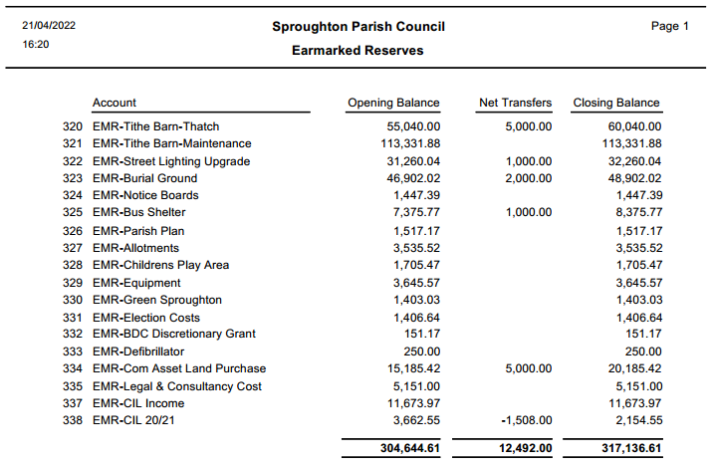
Finances cont…..

Slide 15
Thank-You’s go to
All the parish councillors who volunteer their time
Sproughton Working Group who have helped enormously with the campaigns against planning applications in the village
The Neighbourhood Plan Committee who have put in significant hours to get us to this point
Our Tithe Barn Warden
Our village caretakers Mike Herbert Ltd
And all the organisations in the village who put so much time and effort in to benefit the community:-
  Primary School, All Saints Church, The Community Shop, The Millennium Green, The PFMC, The Reading Room, Brownies, Bumble Bees charity, Fireworks Team.

Slide 16
Questions under #6

