Slide 1
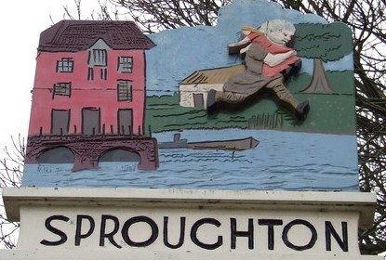
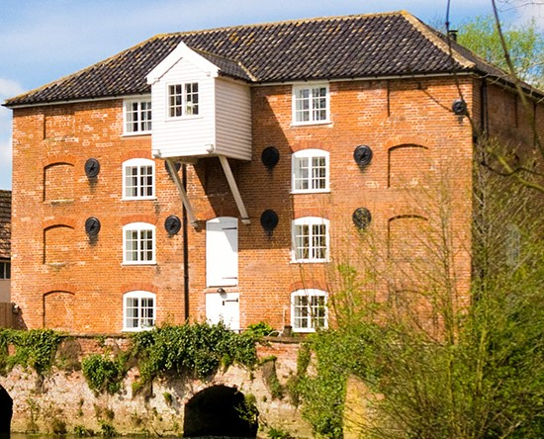
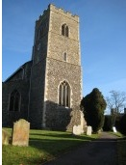
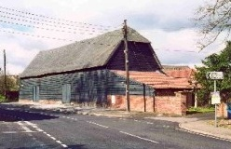
Sproughton Parish Council
Annual Parish Meeting (Year End 31Mar24)
Tuesday 14th May 2024

Slide 2
Sproughton Parish Council
Our Councillors
  Jennifer King (Chair), Sharon Maxwell (Vice Chair), Simon Curl, Helen Davies, Peter Powell, Tracy Booth, Charlie Barber, Rhona Jermyn and Darren Smith.
  Our Clerk
  Kirsty Webber.
  Kirsty can be contacted at SproughtonPC@gmail.com,
  07538 311567,
  Tithe Barn, Lower Street, Sproughton IP8 3AA

Slide 3
Our Committees
Planning Committee
Neighbourhood Plan Committee
Sproughton PC
Finance Committee
Burial Committee
HR Committee
Beer Festival Committee

Slide 4
The Past Year – Committees
Sproughton Parish Council Committee
  Met every month including the normal holiday month of August due to the volume of work
Planning Committee
  Met fortnightly, each month to consider 56 planning applications. There were many additional meetings.
Finance Committee
  Met three times to consider financial matters such as budgets, precept & annual audit.
HR Committee- Have not met this year.
Burial Committee
  Have not met this year
Neighbourhood Planning Committee
  Formed early 2020.
  Beer Festival Committee
  Has met to arrange the annual Beer Festival, which was held at the weekend.

Slide 5
Allotments
The Parish Council leases the allotments from the Felix Thornley Cobbold Trust and manages these on a day-to-day basis.
FTCT annual rent = £445.00
Rental income from plot holders = £921.00
payments are now in advance rather than
arrears.
Water Rates = £601.00
There are currently no plots available.

Slide 6
Burial Ground
Sproughton PC authorises burials and the erection of memorials.
SPC is responsible for the management of the burial ground in Church Lane
Regular maintenance takes place e.g. grass & hedges cut, paths cleared & swept and cleared.
Sproughton PC has continues to consider expansion of the burial ground

Slide 7
Tithe Barn
Sproughton PC manages the use, maintenance & improvement of this important village resource. This year unfortunately the barn insurance increased to £23,000, we have had therefore had to increase the hire fees of the barn.
Our Tithe Barn warden is David Barnes and Deputy Barn warden is Sam Pateman-Gee who manages day to day use of the barn, assists with hiring arrangements, ‘meets and greet’ hirers and overseas any functions.
Mike & Shirley Herbert are our Tithe Barn Caretakers who maintain the barn.
Sproughton PC is the ‘Designated Premises Supervisor’ administering the requirements of the Premises Licence (change to previous arrangements).

Slide 8
Sproughton PC – Planning Work
Chantry Vale
Sproughton Enterprise Park

Slide 9
Sproughton Neighbourhood Plan
This project began in Jan’20
Neighbourhood Plan Committee set-up consisting of members of the Parish Council & Sproughton Working Group, chaired by Rhona Jermyn of the SWG
Following a referendum held on Tuesday 21 November 2023, in which more than half of those who voted did so in favour of the Plan, Babergh District Council has decided to ‘make’ (adopt) the Sproughton Neighbourhood Plan as part of its development plan.

Slide 10
SPROUGHTON NEIGHBOURHOOD PLAN
CONT…..
The result means that Babergh District Council must now ‘make’ (adopt) the Sproughton Neighbourhood Plan unless it considers that it would be in breach of any EU obligations or any of the Convention Rights (within the meaning of the Human Rights Act 1998). The District Council is satisfied that the Sproughton Neighbourhood Plan is not in breach of these obligations.

Slide 11
Events
We held many successful events this year.
Beer Festival
The Coronation Celebration
Afternoon Tea
The Christmas Weekend

Slide 12
PLAYING FIELD
At their AGM (25/10/23), all the attending members of the Playing Field Management Committee (PFMC) resigned, with the remaining member resigning the following day (26/10/2023) therefore dissolving the PFMC.
As set out in the playing field deeds, responsibility for the playing fields now transfers to the Parish Council (as custodian trustees).
The Parish Council have sought advice from their solicitors and have now applied to the charity commission to become the sole trustees to enable the parish council to run the playing fields to ensure the long-term usage for all Parishioners.
We immediately instructed Wicksteed to carry out the required maintenance works to allow the re-opening of the play area which was ready in time for February half term.
The Parish Council would like to thank all of the PFMC members for the time and dedication given to the running of the playing fields.

Slide 13
Finances
FINANCE REPORT1
Budget | £77,146.00 | Precept | £69,266.00
Expenditure
Burial Ground | £ 1333.00 | VAT | £ 10835.00
Allotments | £ 1101.00 | Tithe Barn | £ 25411.00
Grants & Other Activities | £ 1860.00 | Administration | £30705.00
Street Lighting | £ 3290.00 | Neighbourh’d Plan | £ 327.00
Play Area/Public spaces | £ 18986.00 | Staff Expenditure | £ 14890.00
 |  | Total Spend | £108738.00

Slide 14
Thank-You’s go to
All the parish councillors who volunteer their time
Sproughton Working Group who have helped enormously with the campaigns against planning applications in the village
The Neighbourhood Plan Committee who have put in significant hours to get us to this point
Our Tithe Barn Wardens
Our village caretakers Mike Herbert Ltd
And all the organisations in the village who put so much time and effort in to benefit the community:-
  Primary School, All Saints Church, The Community Shop, The Millennium Green, The Reading Room, Brownies, Bumble Bees charity.

Slide 15
Questions under #6

